Slide 1


Submitted By:
Bhawan Wadhwa -1810991106
Harsh Gabba -1810991126
Submitted To: Mrs. Pritika Goel

Slide 2

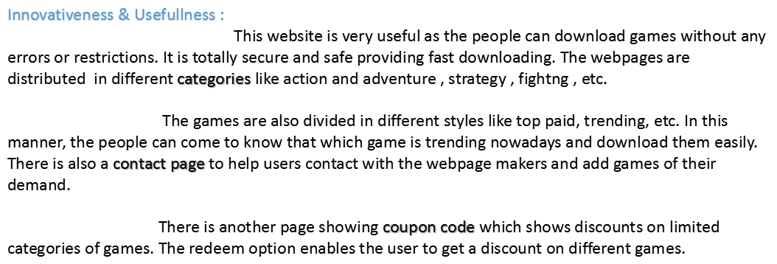

Slide 3
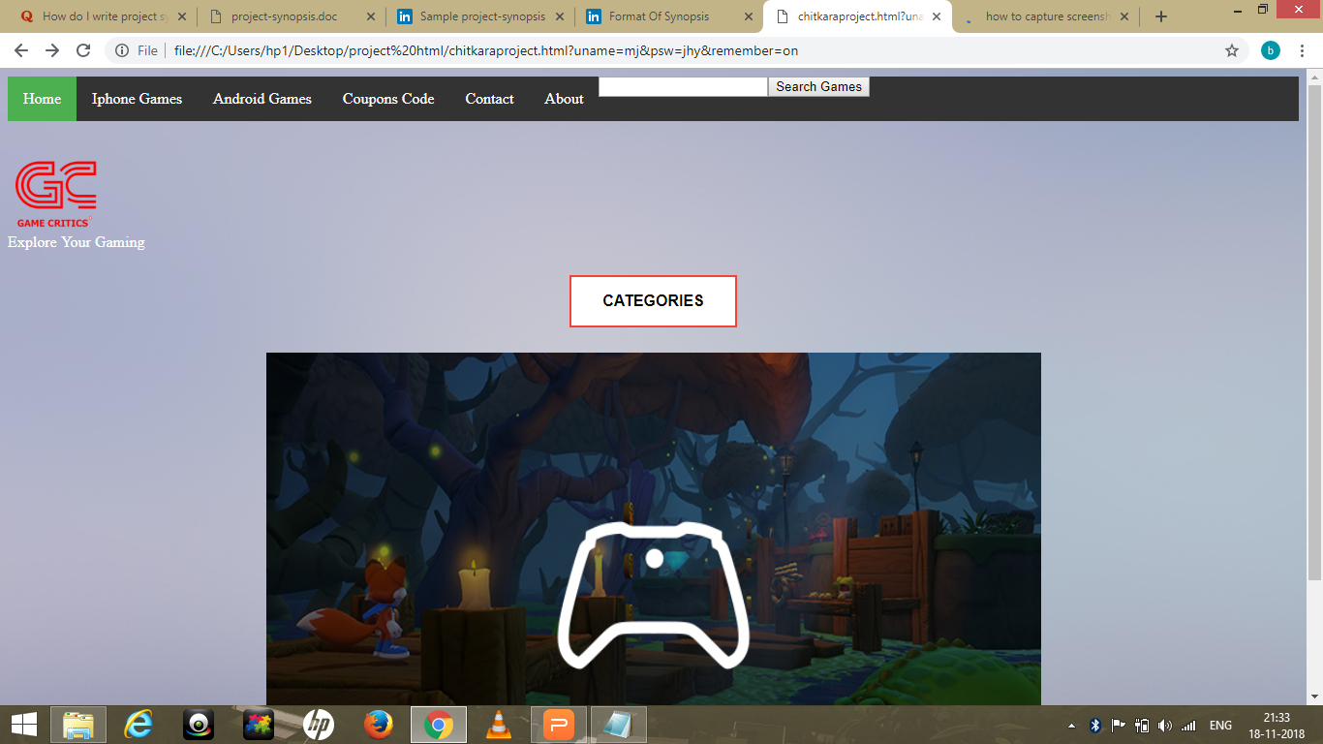

Slide 4
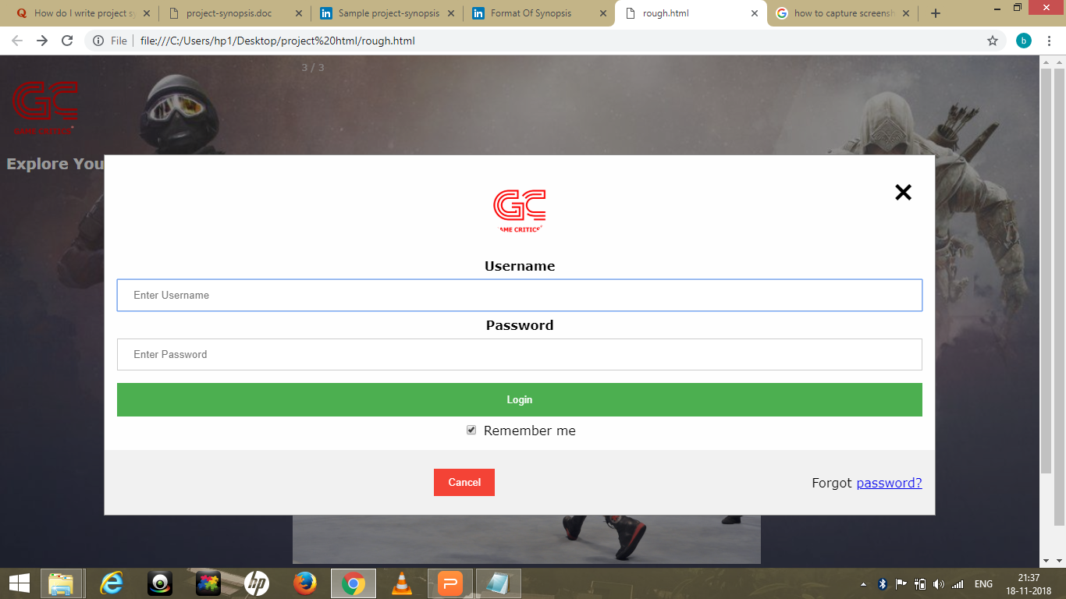

Slide 5
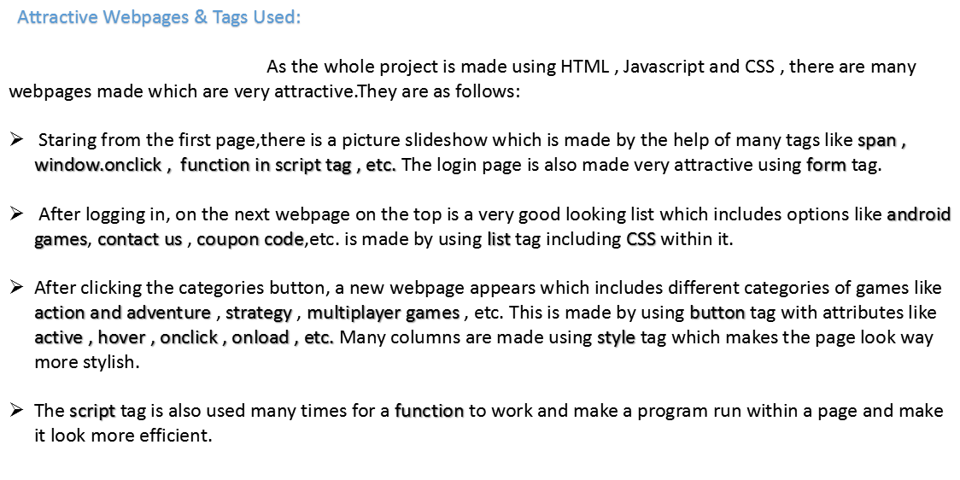

Slide 6
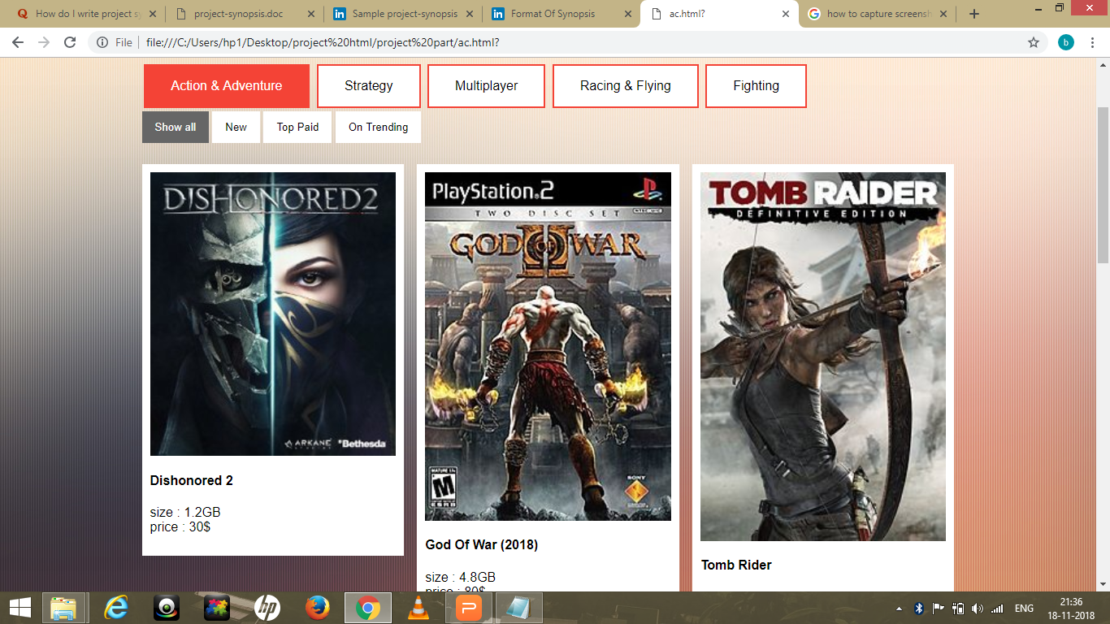

Slide 7



